Slide 1
EEE Lecture-19 Chapter -11 Inductor

Slide 2

11.4 Permeability
If cores of different materials with the same physical dimensions are used in the electromagnet, the strength of the magnet will vary in accordance with the core used.
This variation in strength is due to the greater or lesser number of flux lines passing through the core.
The permeability (μ) of a material, therefore, is a measure of the ease with which magnetic flux lines can be established in the material.
Materials in which flux lines can readily be set up are said to be magnetic and to have high permeability.
It is similar in many respects to conductivity in electric circuits. The permeability of free space μ_{o} (vacuum) is

Slide 3
11.4 Permeability
The permeability of all nonmagnetic materials, such as copper, aluminum, wood, glass, and air, is the same as that for free space (vacuum).
Materials that have permeability slightly less than that of free space are said to be diamagnetic
Those with permeability slightly greater than that of free space are said to be paramagnetic.
Magnetic materials, such as iron, nickel, steel, cobalt, and alloys of these metals, have permeability hundreds and even thousands of times that of free space. Materials with these very high permeability are referred to as ferromagnetic.

Slide 4
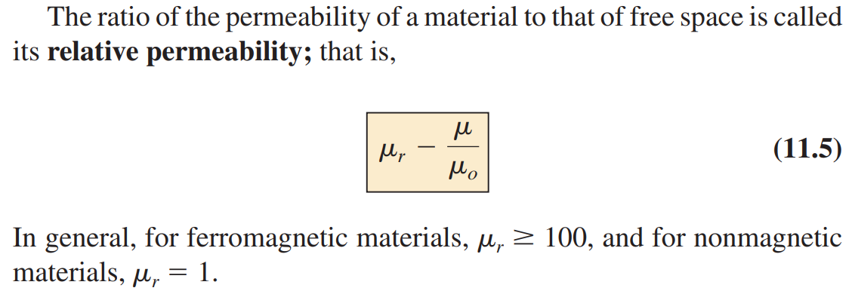
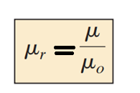
Relative Permeability

Slide 5
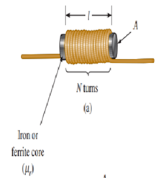
11.3 Inductance
Sending a current through a coil of wire, with or without a core, establishes a magnetic field through and surrounding the unit.
This simple construction (see Fig. 11.16), is called an inductor (often referred to as a coil).
Its inductance level determines the strength of the magnetic field around the coil due to an applied current.
The higher the inductance level, the greater the strength of the magnetic field.
In total, therefore, inductors are designed to set up a strong magnetic field linking the unit, whereas capacitors are designed to set up a strong electric field between the plates.

Slide 6
11.3 Inductance
Inductance is measured in henries (H), after the American physicist Joseph Henry. Most applications, use inductors are of the millihenry (mH) or microhenry (mH) range.
1 henry is the inductance level that will establish a voltage of 1 volt across the coil due to a change in current of 1 A/s through the coil.

Slide 7
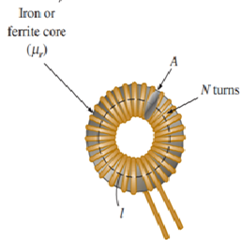
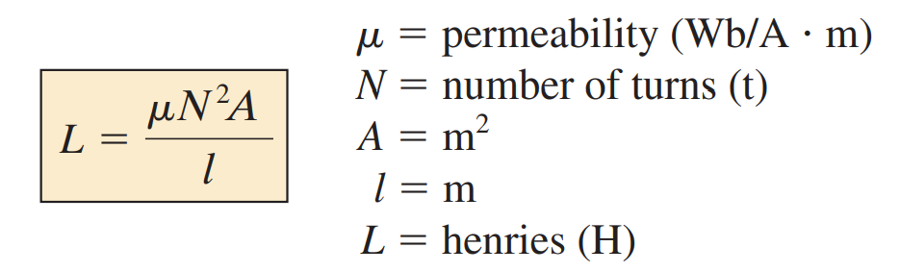
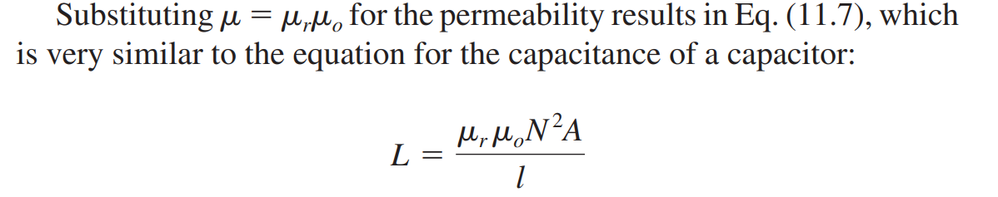
Inductor Construction
Level of inductance dependent on the area(A) within the coil, the length(l) of the unit, and the permeability(µ) of the core material.
It is also sensitive to the number of turns (N) of wire in the coil as dictated by Eq. (11.6) and defined in Fig. 11.16 for two of the most popular shapes:

Slide 8
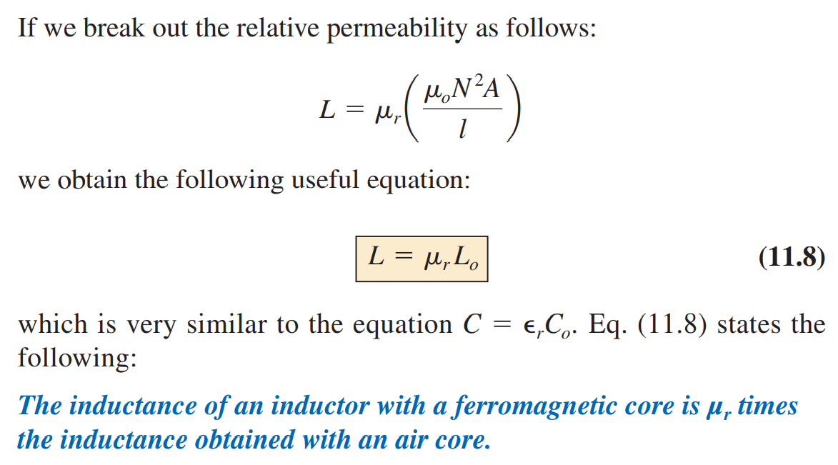

Slide 9
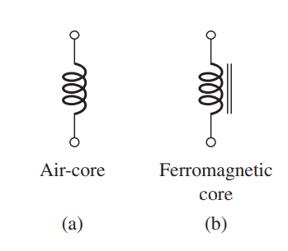
Types of Inductors
Inductors, like capacitors and resistors, can be categorized under the general headings fixed or variable. The symbol for a fixed air-core inductor is provided in Fig. 11.20(a).
Fixed-type inductors come in all shapes and sizes. However, in general, the size of an inductor is determined primarily by the type of construction, the core used, or the current rating.

Slide 10
Electromagnetic Induction
Electromagnetic Induction was first discovered way back in the 1830’s by Michael Faraday.
Faraday noticed that when he moved a permanent magnet in and out of a coil or a single loop of wire, it induced an ElectroMotive Force or emf, in other words a Voltage, and therefore a current was produced.

Slide 11
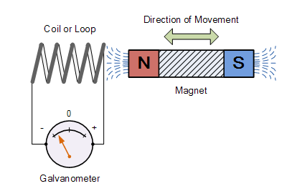
Electromagnetic Induction
When the magnet is moved “towards” the coil, the pointer of the Galvanometer, will deflect away from its center position in one direction only.
When the magnet stops moving and is held stationary with regards to the coil the needle of the galvanometer returns back to zero.
Likewise, when the magnet is moved “away” from the coil in the other direction, the needle of the galvanometer deflects in the opposite direction.
Then by moving the magnet back and forth towards the coil the needle of the galvanometer will deflect left or right, positive or negative, relative to the directional motion of the magnet.

Slide 12
Electromagnetic Induction
If the magnet is now held stationary and only the coil is moved towards or away from the magnet the needle of the galvanometer will also deflect in either direction.
Then we can see that the faster the movement of the magnetic field the greater will be the induced emf or voltage in the coil.

Slide 13
Faraday’s Law of Electromagnetic Induction:
Michael Faraday’s famous law of electromagnetic induction states:
“that a voltage is induced in a circuit whenever relative motion exists between a conductor and a magnetic field and that the magnitude of this voltage is proportional to the rate of change of the flux”.

Slide 14
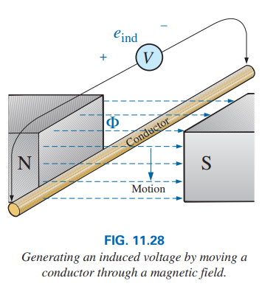
11.4 Induced Voltage v_{L}
Faraday’s Law of Electromagnetic Induction:
If a conductor is moved through a magnetic field so that it cuts magnetic flux lines, a voltage will be induced across the conductor, as shown in Fig.
The greater the number of flux lines cut per unit time (by increasing the speed with which the conductor passes through the field), or the stronger the magnetic field strength, the greater will be the induced voltage across the conductor.
If the conductor is held fixed and the magnetic field is moved so that its flux lines cut the conductor, the same effect will be produced.

Slide 15
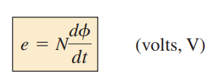
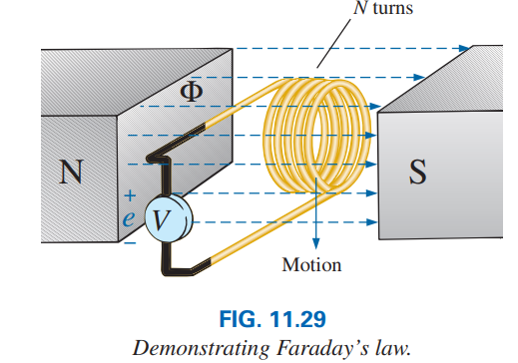
11.4 Induced Voltage v_{L}
If a coil of N turns is placed in the region of a changing flux, as in the following Fig., a voltage will be induced across the coil as determined by Faraday’s law:
where N represents the number of turns of the coil
The term dΦ/dt is the change in flux (in webers) linking the coil with time.

Slide 16
Faraday’s Law of Electromagnetic Induction:
So how much voltage (emf) can be induced into the coil using just magnetism is determined by the following 3 different factors.
Increasing the number of turns of wire in the coil (N) – if there are 20 turns in the coil there will be 20 times more induced emf than in one piece of wire.
Increasing the speed of the relative motion between the coil and the magnet – If the same coil of wire passed through the same magnetic field but its speed or velocity is increased, the wire will cut the lines of flux at a faster rate so more induced emf would be produced.
Increasing the strength of the magnetic field – If the same coil of wire is moved at the same speed through a stronger magnetic field, there will be more emf produced because there are more lines of force to cut.

Slide 17
11.4 Induced Voltage v_{L}
The greater the N or the faster the coil is moved through the magnetic flux pattern, the greater the induced voltage.
If the magnetic flux passing through a coil remains constant—no matter how strong the magnetic field—the term will be zero, and the induced voltage zero volts.
The only requirement is that the flux linking (passing through) the coil changes with time.

Slide 18
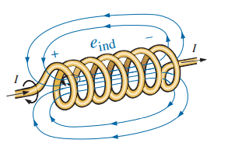
11.4 Induced Voltage v_{L}
It is very important to that the polarity of the induced voltage across the coil is such that it opposes the increasing level of current in the coil.
In other words, the changing current through the coil induces a voltage across the coil that is opposing the applied voltage.
The quicker the change in current through the coil, the greater the opposing induced voltage to suppress the attempt of the current to increase in magnitude.
This “choking” action of the coil is the reason inductors or coils are often referred to as chokes.

Slide 19
11.4 Lenz’s Law
The choking reaction above is true for increasing or decreasing levels of current through the coil. This effect is an example of a general principle known as Lenz’s law, which states that
an induced effect is always such as to oppose the cause that produced it.

Slide 20
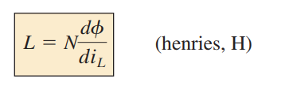
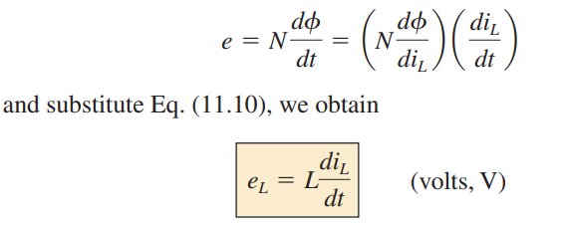
11.4 Induced Voltage v_{L}
The inductance of a coil is a measure of the change in flux linking a coil due to a change in current through the coil; that is,
where N is the number of turns, Φ is the flux in webers, and i is the current through the coil.
Larger the inductance of a coil (with N fixed), the larger will be the change in flux linking the coil due to an instantaneous change in current through the coil.
It reveals that the magnitude of the voltage across an inductor is directly related to the inductance L and the instantaneous rate of change of current through the coil.

Slide 21
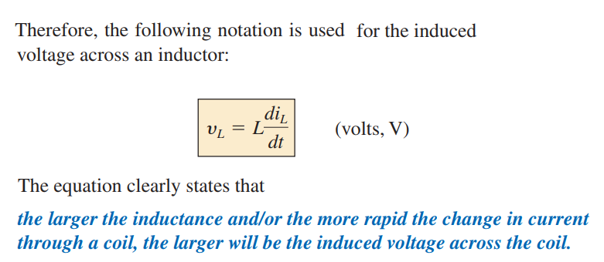
11.4 Induced Voltage v_{L}

Slide 22
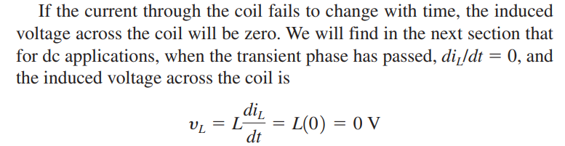
11.4 Induced Voltage v_{L}

Slide 23
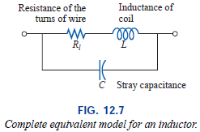
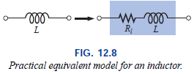
Inductor
Inductors, like capacitors, are not ideal.
Associated with every inductor are a resistance equal to the resistance of the turns and a stray capacitance due to the capacitance between the turns of the coil.
To include these effects, the equivalent circuit for the inductor is as shown in Fig.

Slide 24
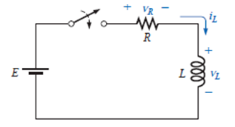
R-L Transients: Storage Cycle
The changing voltages and current that result during the storing of energy in the form of a magnetic field by an inductor in a dc circuit can best be described using the circuit of Fig.

Slide 25
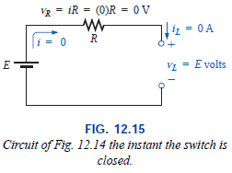
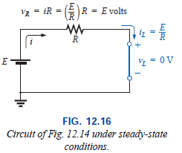
R-L Transients: Storage Cycle
At the instance the switch is closed, the potential drop across the coil, v_{L}, will equal the applied voltage E as determined by Kirchhoff’s voltage law since v_{R} = iR = (0)R = 0 V.
The current i_{L} will then build up from zero, establishing a voltage drop across the resistor and a corresponding drop in v_{L}.
The current will continue to increase until the voltage across the inductor drops to zero volts and the full applied voltage appears across the resistor.

Slide 26
R-L Transients: Storage Cycle
Initially, the current i_{L} increases quite rapidly, followed by a continually decreasing rate until it reaches its maximum value of E/R.
A capacitor has a short-circuit equivalent when the switch is first closed and an open-circuit equivalent when steady-state conditions are established.
The inductor has a open-circuit equivalent when the switch is first closed and an short-circuit equivalent when steady-state conditions are established.

Slide 27
R-L Transients: Storage Cycle
When steady-state conditions have been established and the storage phase is complete, the “equivalent” network will appear as shown in Fig. 12.16.
The network clearly reveals the following:
An ideal inductor (R_{l} = 0 ) assumes a short-circuit equivalent in a dc network once steady-state conditions have been established.

Slide 28
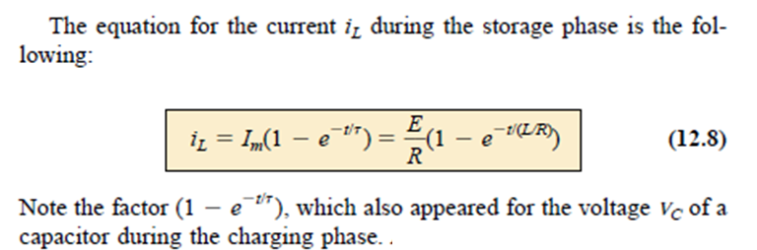
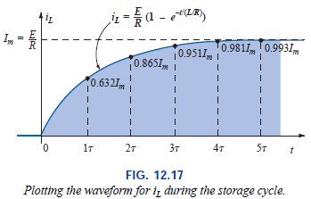
R-L Transients: Storage Cycle

Slide 29
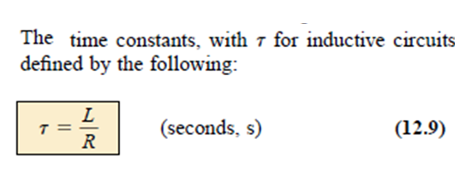
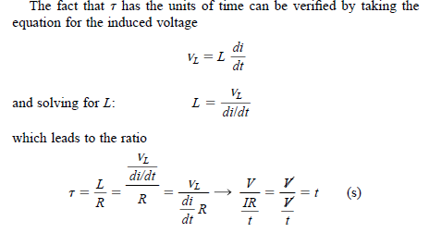
R-L Transients: Storage Cycle

Slide 30
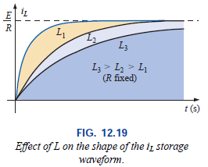
R-L Transients: Storage Cycle
If we keep R constant and increase L, the ratio L/R increases and the rise time increases. The change in transient behavior for the current i_{L} is plotted in Fig. 12.19 for various values of L.

Slide 31
R-L Transients: Storage Cycle
For most practical applications, we will assume that
the storage phase has passed and steady-state conditions have been established once a period of time equal to five time constants has occurred.
In addition, since L/R will always have some numerical value, even though it may be very small, the period 5τ will always be greater than zero, confirming the fact that
the current cannot change instantaneously in an inductive network.

Slide 32
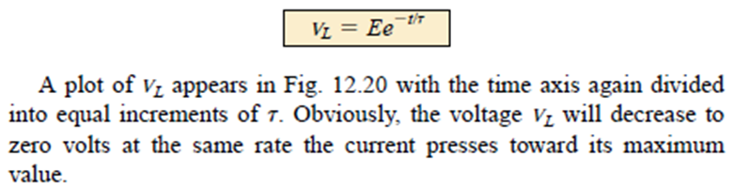
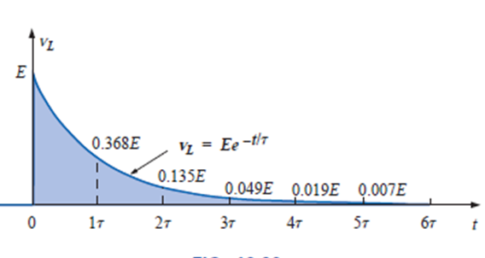


R-L Transients: Storage Cycle
The voltage across the coil jumps to E volts when the switch is closed and decays to zero volts with time. The decay occurs in an exponential manner, and v_{L} during

Slide 33
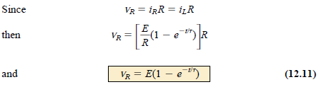
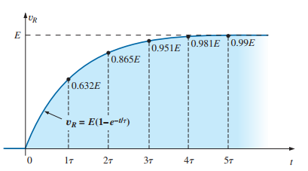
R-L Transients: Storage Cycle
Example: 11.3

Slide 34
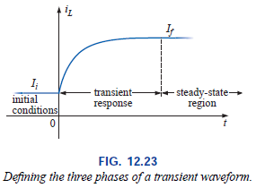
Initial Value
Since the current through a coil cannot change instantaneously, the current through a coil will begin the transient phase at the initial value established by the network before the switch was closed.

Slide 35

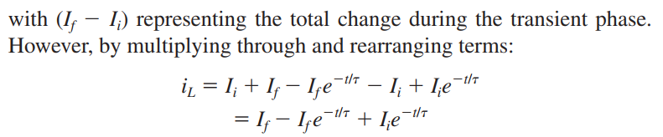

Initial Value
It will then pass through the transient phase until it reaches the steady-state (or final) level after about five time constants.
The steady-state level of the inductor current can be found by simply substituting its short circuit equivalent (or R_{l} for the practical equivalent) and finding the resulting current through the element.
Using the transient equation developed in the previous section, an equation for the current i_{L} can be written for the entire time interval of Fig. 12.23; that is,
Example 11.4

Slide 36
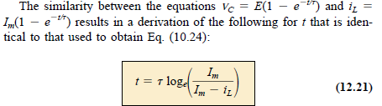
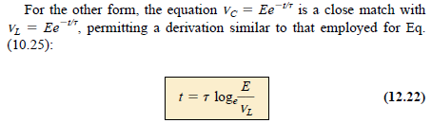
Instantaneous Values
The instantaneous values of any voltage or current can be determined by simply inserting t into the equation.

Slide 37
Thevenin Equivalent: τ = L/R_{Th}
Occasions will arise in which the network does not have the simple series form. It will then be necessary first to find the Thévenin equivalent circuit for the network external to the inductive element.
E_{Th} will then be the source voltage E, and R_{Th} will be the resistance R. The time constant is then τ = L/R_{Th}.
Examples: 11.6, 11.7

Slide 38
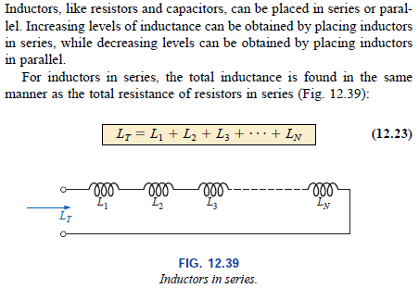
Inductors in Series and Parallel

Slide 39
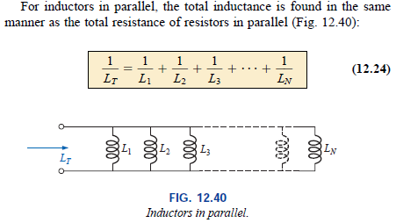

Inductors in Series and Parallel
Example 11.9

Slide 40
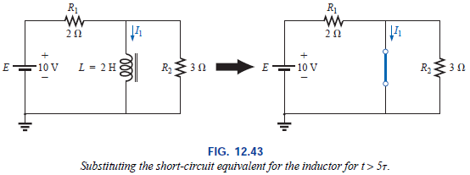
R-L and R-L-C Circuits with dc Inputs
We have found that, for all practical purposes, an inductor can be replaced by a short circuit in a dc circuit after a period of time greater than five time constants has passed.
If in the following circuits we assume that all of the currents and voltages have reached their final values, the current through each inductor can be found by replacing each inductor with a short circuit.

Slide 41


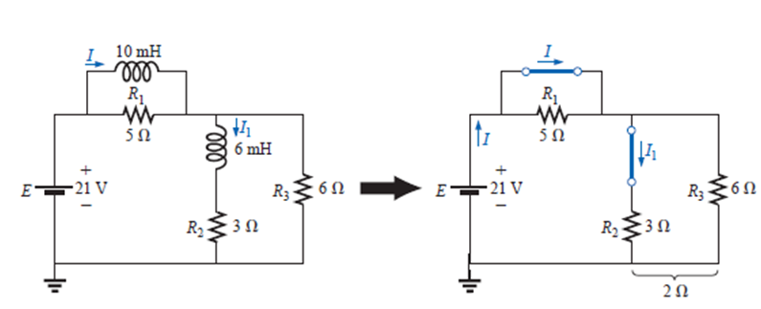
R-L and R-L-C Circuits with dc Inputs
Example: 11.11

Slide 42
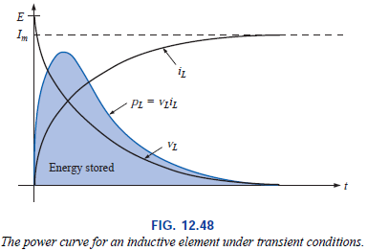
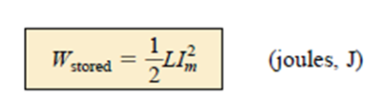
Energy Stored by an Inductor
The ideal inductor stores the energy in the form of a magnetic field.
A plot of the voltage, current, and power to an inductor is shown in the following Fig. during the buildup of the magnetic field surrounding the inductor.
The energy stored is represented by the shaded area under the power curve.
Using calculus, we can show that the evaluation of the area under the curve yields
Example: 11.12

Slide 43
Thank You

